Slide 1
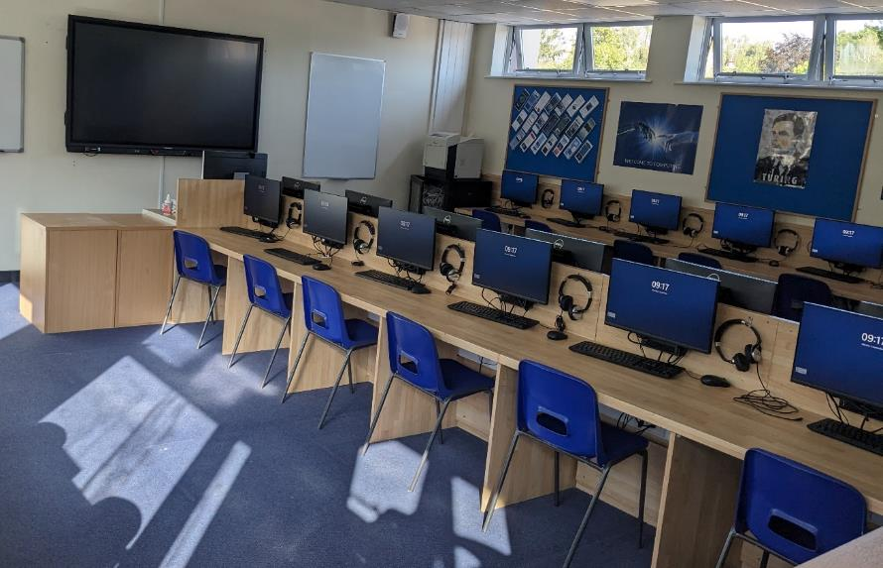
Years 1-5 IT Acceptable Use Policy Summary
By following these simple dos and don'ts, you can enjoy using technology safely and responsibly while at school! If ever in doubt, always seek assistance from a teacher or the IT helpdesk.
Notes:
Explain that they can read the entire thing on the website if they wish, but this is a simplified version to make it easier for them.

Slide 2
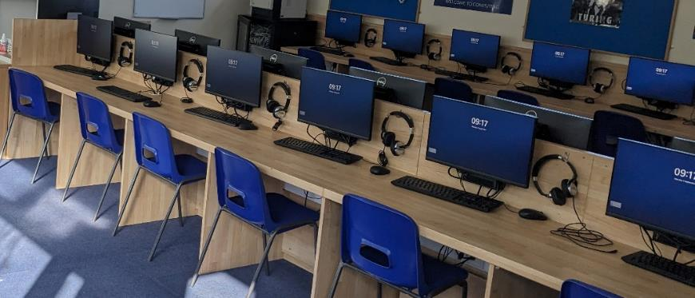
It covers:
Any technology on the school site (including your own)
Use of technology involving Churcher’s pupils (including social media/photos)
School e-mail, Firefly, OneDrive, Teams etc - at home as well as at school
School computers/mobile devices/Internet/BYOD WiFi
Notes:
Go through this with them, but also explain about sanctions that can be applied: detentions, contact home, disabling of account/email/Internet access etc

Slide 3
General DO’s
Remember that breaking the policy can carry serious sanctions
Think before using any Churcher’s technology – usage is monitored/logged
Treat school technology with respect – they are shared resources
Keep your password secret and change it if you think someone knows it
Tell a teacher or email support@churcherscollege.com If you find problems/damage with electronic resources, equipment or passwords
Ask if you’re not sure if something is allowed!
Notes:
Go through this with them, but also explain about sanctions that can be applied: detentions, contact home, disabling of account/email/Internet access etc

Slide 4
Internet DO’s
When directed to: use the school’s Internet for learning and schoolwork ONLY
Tell a trusted adult or use the CEOP button on Firefly if you’re worried about something you’ve seen on the Internet or other technology
Turn off location sharing on mobile apps/social media/camera apps
Only use the school's BYOD WiFi Internet access when on school grounds
Notes:
Go through this with them, but also explain about sanctions that can be applied: detentions, contact home, disabling of account/email/Internet access etc

Slide 5
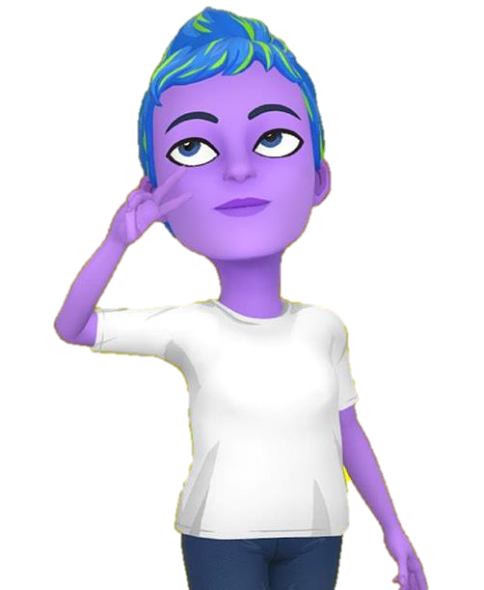
Internet Don'ts
Don’t download or open files that might be programs/contain viruses
Don’t access/take/share others’ information or pictures without their permission
Don’t enter personal/confidential information that can be used to identify/find you or other students into AI tools or other platforms/apps/websites
Don’t pretend someone else’s work is your own – that’s Plagiarism – this includes AI-generated resources (ChatGPT and more)
Don’t share/use copyright-protected images – this includes school/company logos
Don’t ever look at, search for, share, or download anything that is extreme, offensive or inappropriate for school
Notes:
Go through this with them, but also explain about sanctions that can be applied: detentions, contact home, disabling of account/email/Internet access etc

Slide 6
Communication DO’s
Use electronic communication such as email/Teams respectfully and politely
Use ONLY school email/Teams to communicate with staff unless told otherwise
Ignore emails from people you don’t know – especially those with links or attached files as it could be a computer virus
Use school communication tools for school-related tasks only
Always be polite and write appropriate messages
Think before clicking send – would you say it to their face?

Slide 7
Access and Security Don'ts
Don’t try to access unauthorized parts of the school computer systems
Don’t tamper with the school’s security, anti-virus, firewall or Internet filters (including the use of VPNs)
Don’t share or attempt to access someone else’s computer or information/files
Don’t physically connect your personal devices to the school network/computers
Don’t plug external devices into school computers (USB flash drives etc.)

Slide 8
This includes phones, tablets, smartwatches, laptops, mp3 players etc! Mobile device Do’s
Go to the school office to use a telephone in emergencies
Keep other devices switched off and stored away during school hours
Parents must contact the school office in an emergency and not your phone
Mobile phones MUST be switched off and stored in your Yondr pouch during school hours

Slide 9
Mobile devices Don’ts
Don’t use or have your mobile device turned on during the school day
Don’t bring personal electronic devices into examination rooms
Don’t use personal/school devices to bully, harass, or intimidate others
Don’t use your phone to contact teachers – unless permitted to do so
Don’t impersonate others or organisations
Don’t use social media unless you are 13 or older (WhatsApp, SnapChat etc.)

Slide 10
Photographs and Images Don’ts
Don’t record photos/video without permission from a teacher and the people in the picture
Don’t share personal images without consent of that person and a teacher
Don’t use photos/videos to bully, harass, or intimidate others
Don’t share images that could be offensive or bring the school into disrepute
Don’t take or share any inappropriate images especially of other pupils - this can lead to serious trouble, including police involvement
Delete photos from any shared school devices when you are finished

