Slide 1
TwilightCraft guide

Slide 2
Using morph
[ and ] : used to open and navigate the morph menu (press enter to select a morph)
V : use morphed ability (some abilities are passive and don’t need you to do this)
Morphing may change your size, so you won’t fit in the normal spaces
Most morphs have different abilities. They are shown by symbols next to the selection box in the morph menu.

Slide 3
Morph abilities

Slide 4
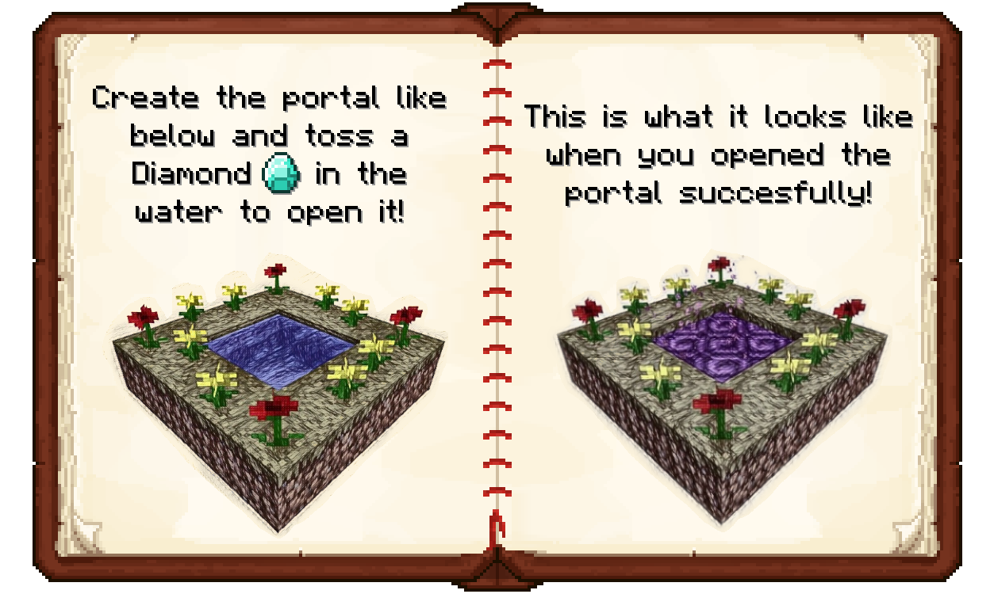
Getting into the twilight forest
To get into the forest, you need to build a portal. This needs 1 diamond, 12 flowers (mixed) and two buckets of water
Find a relatively flat area and dig a 2 x 2 hole surrounded by grass. The place the flowers around the edges of the hole and fill the hole with water (not flowing)
Throw the diamond into the water and stand back
The water will be struck by lightning and will turn into a portal.
Go through the portal to reach the twilight forest

Slide 5
The progression system
When you first enter the be twilight forest, you will not be able to enter some areas
This is caused by the progression system, which forces you to follow the story in chronological order
To unlock new areas you must complete tasks in ones you can already enter, such as killing the naga in the courtyard.
Be careful with this, as the progression system uses obscure triggers to unlock new areas. If you cannot enter the next area, check it is the place you think it is

Slide 6
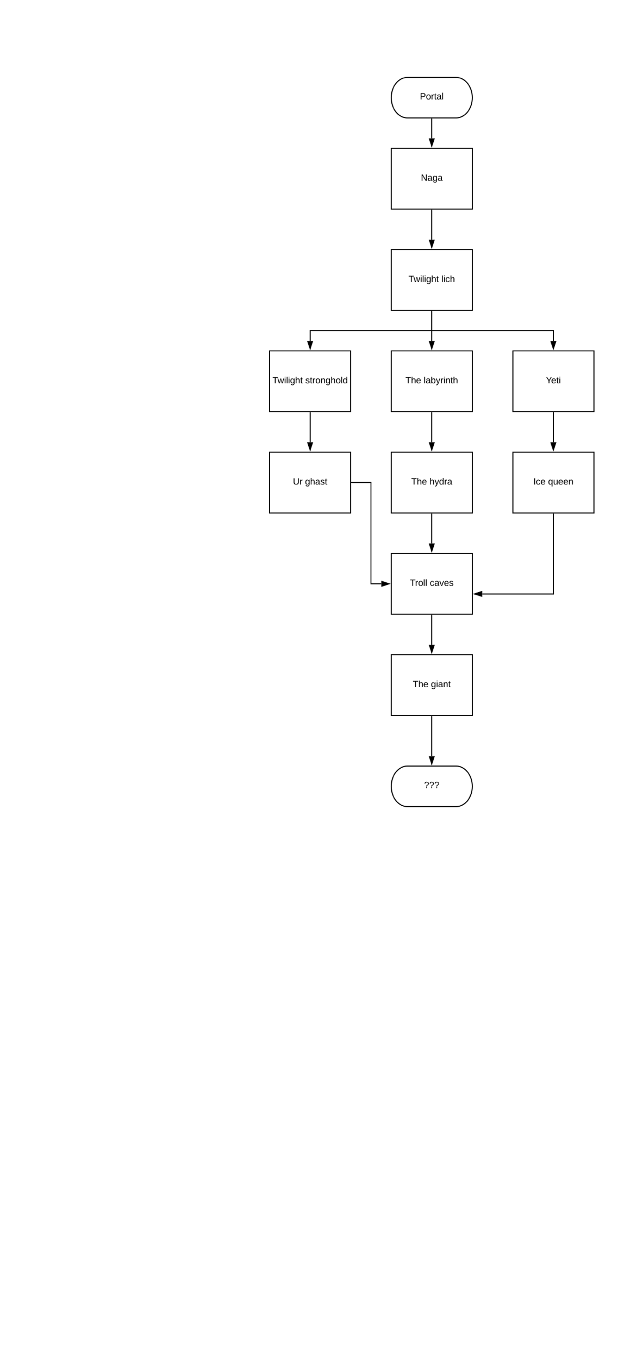
The progression tree
This is going to take a while

Slide 7
Differences from normal Minecraft
Due to the mods and the edition of Minecraft used, some parts of the game may seem unfamiliar at times
Homeblocks and teleporting : Homeblocks allow you to teleport back to a place at any time by pressing m (which can also be used to teleport to the spawnpoint)
Gravestones : When you die, instead of dropping your items a gravestone appears. Break it to receive your loot. Be careful near spawn, as you will not be able to break your gravestones there. Taking other people’s items is not allowed, and is bannable.
Morph: When you kill something you are able to change into it. If you find a mob you cannot kill, it is most likely a player
Grief protect : You are unable to break blocks near spawn or hurt other players. If you are unable to break or place things, you are most likely too close to spawn
Lag : there can be lag issues, and the server times out every now and again. There is nothing we can do about this. If a block does not drop an item, or you cannot access a GUI, or an entity freezes, be patient as the issue will resolve itself soon

